Slide 1


SALES REPORT 2011 – 2014
PREPARED BY TEAM AIME

Slide 2


AGENDA
Brief Performance Overview
Profitability by Categories
Focus on Technology
Profitability by Subcategory
Profitability by Product
Yearly and quarterly performance
Investigation of 2013-Q3
Notes:
Do we say where we got the image from? For copyright stuff?

Slide 3




BRIEF PERFORMANCE OVERVIEW
Sales ($)
Profits ($)
No. of Customers
No. of Countries Shipped To
12,642,507
1,467,457
796
147

Slide 4
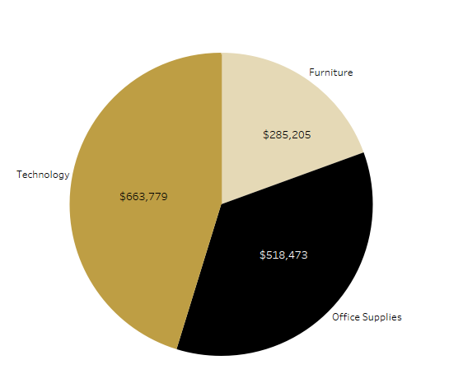
Total Profits by Categories
Technology is our most profitable product category making up 45% of total profits.
Followed by Office Supplies and Furniture making up 35% and 20% of profits, respectively.

Slide 5
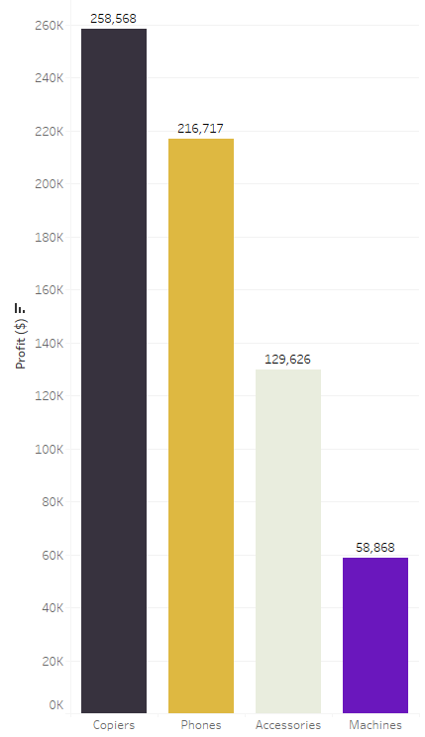
Total Profits by Subcategories in Technology
Copiers are the most profitable sub-category within Technology making up 39% of total profits.
Followed by Phones, Accessories, and Machines making up 33%, 20%, and 8% of profits, respectively.

Slide 6
Has the technology category always been profitable?

Slide 7
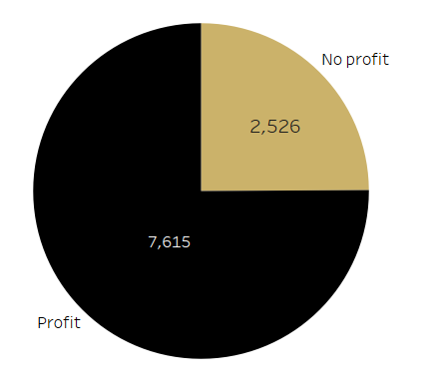
Number of Technology Products Sold that were Profitable
10,141 Technology products were sold in total.
75% of all Technology products sold were profitable

Slide 8
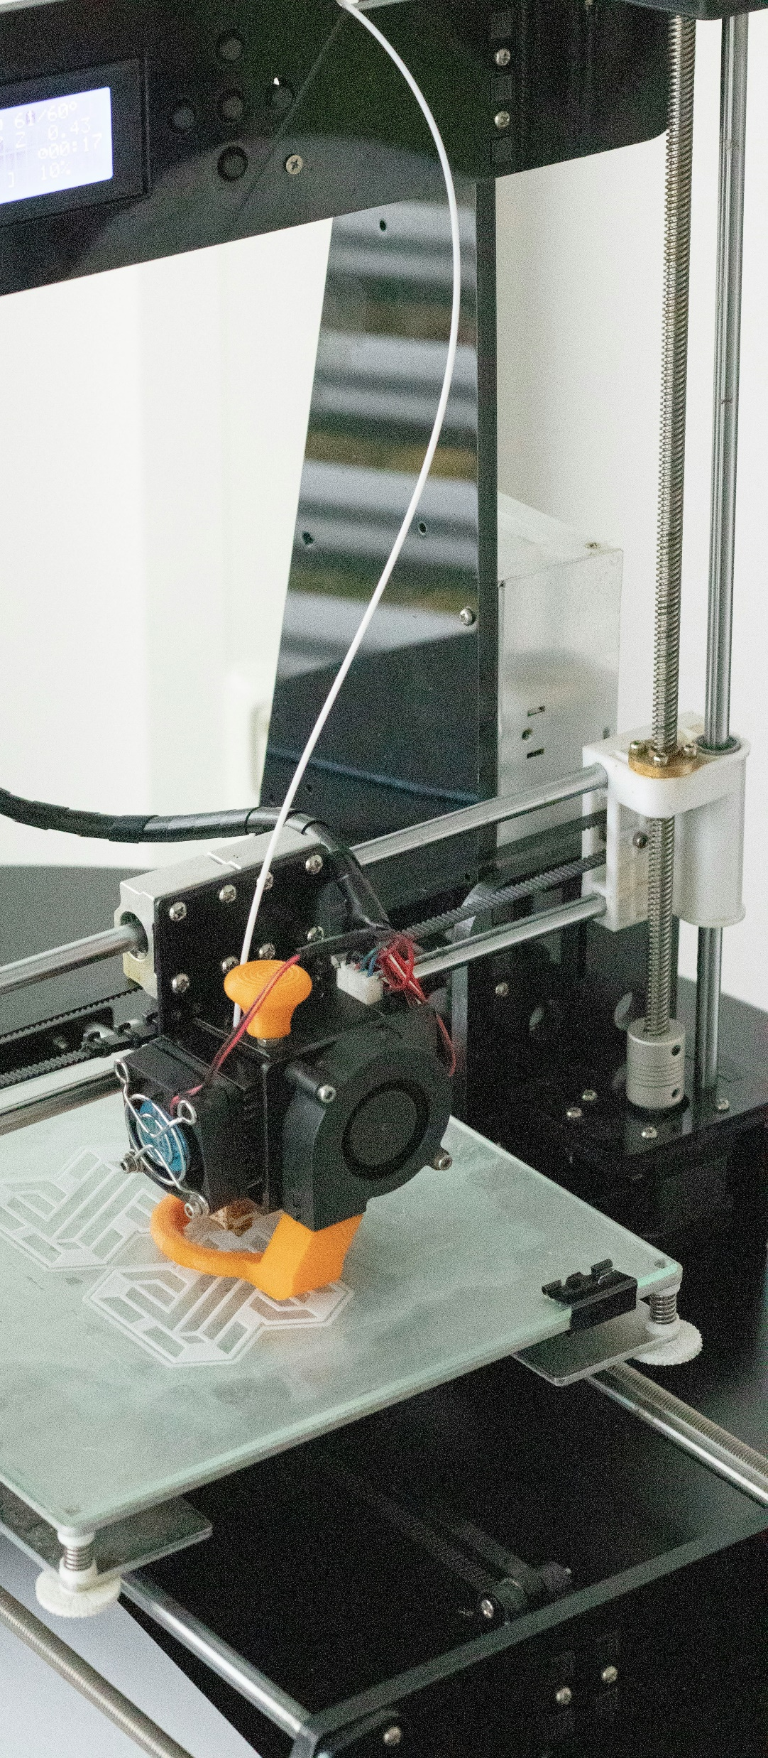

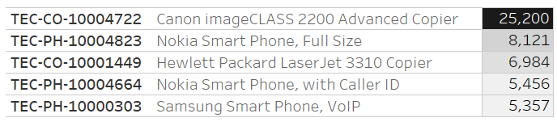

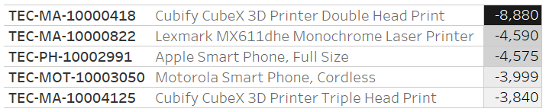
Top 5 Best and Worst Performing Technology Products
Product ID | Product Name | Profit ($)
Product ID | Product Name | Profit ($)
Notes:
2 types of copiers and 3 types of phones for best?
3 machines and 2 phones for worst?

Slide 9

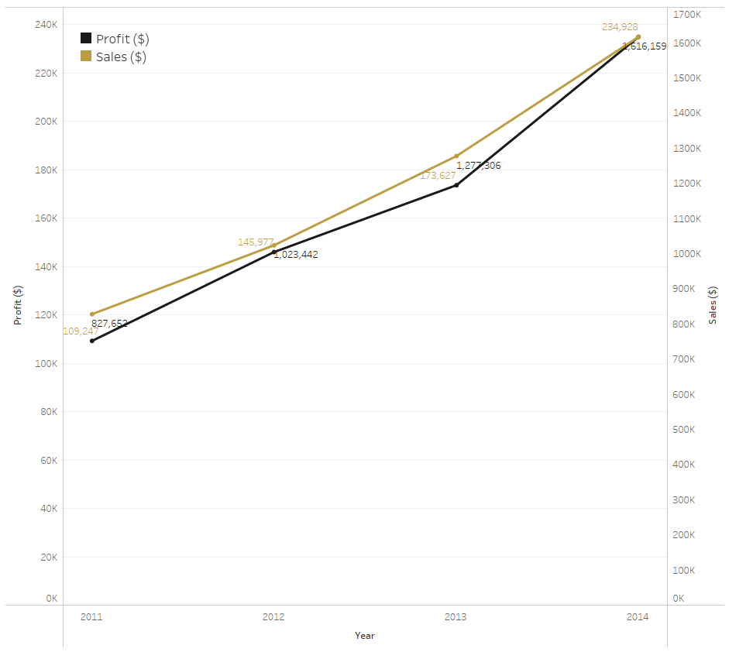

Yearly total technology sales and profit
Increase in both sales and profits from 2011 to 2014
Image from Freepik

Slide 10
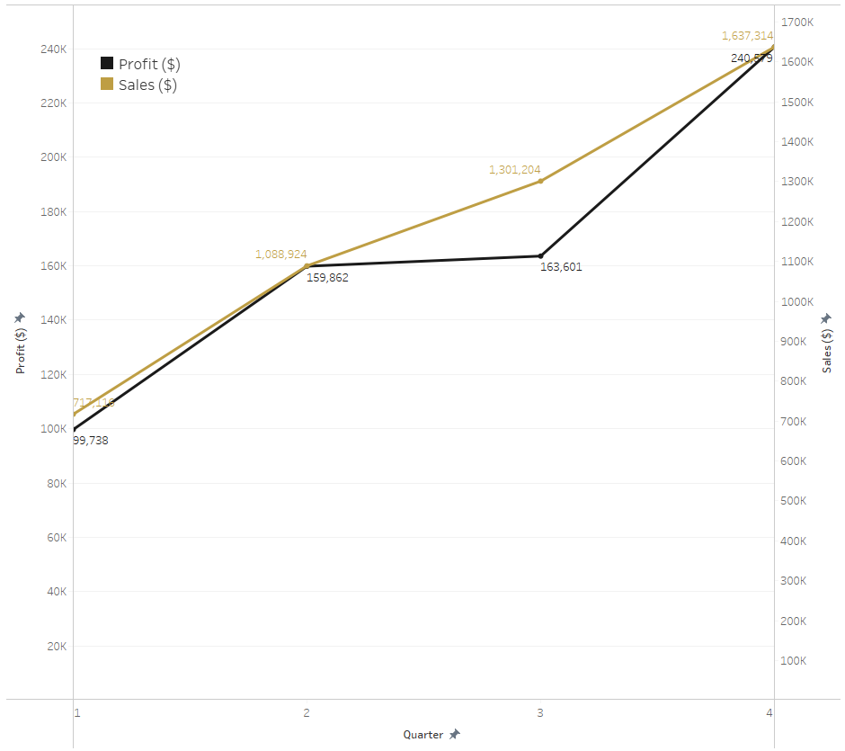

Quarterly total technology sales and profit
Steady increase in sales
Stagnant profit between Q2 to Q3
Image from Freepik

Slide 11
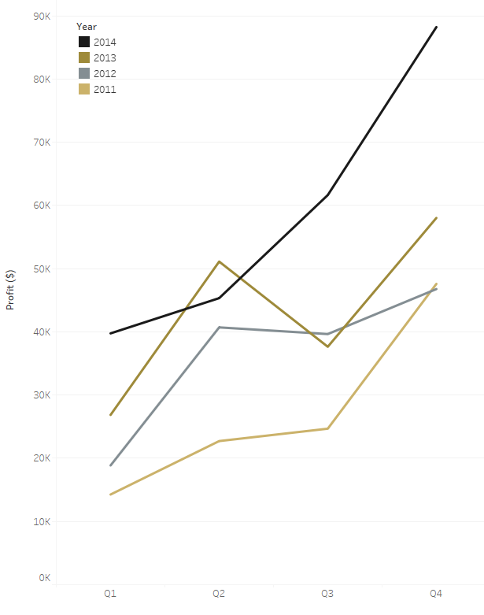
Quarterly total technology profit by year
2011 and 2014 – increase in profit across all quarters
2012 – small decrease between Q2 and Q3
2013 – large decrease between Q2 and Q3
What happened in 2013 Q3?

Slide 12
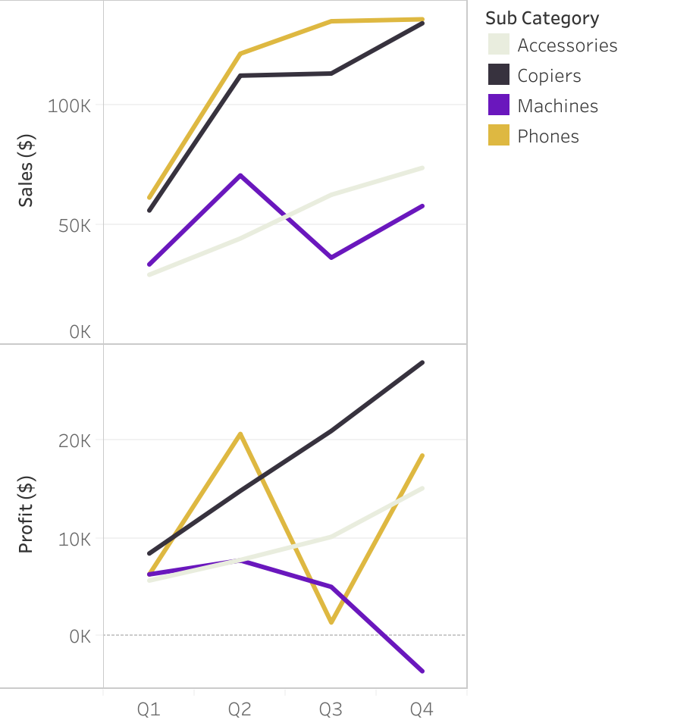
What happened in 2013 Q3?
Quarterly Performance of Subcategories for 2013
Phones sales higher than any other subcategory in every quarter of 2013
Profitability of phones drops steeply in Q3
Machine sales become less profitable Q3, but do not impact Q3 greatly due to low sale figure comparatively

Slide 13
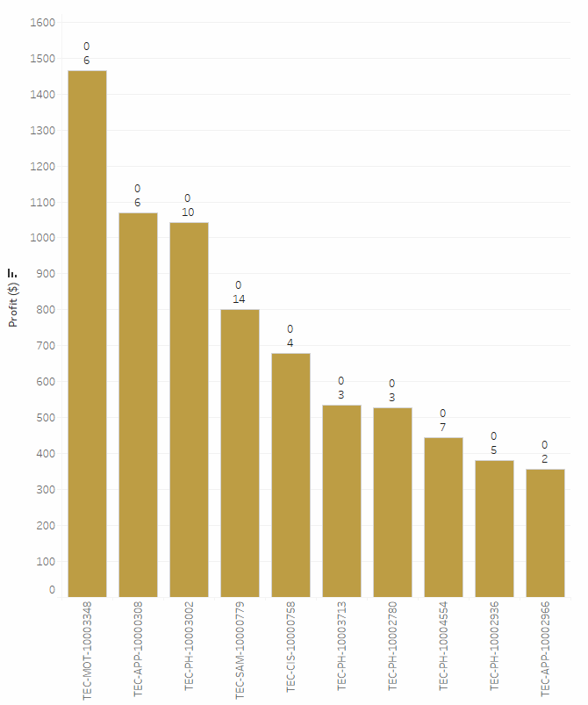
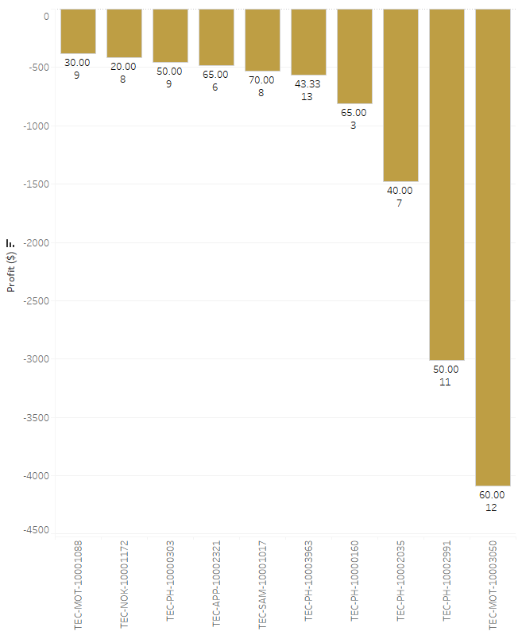
Top 10 Best and Worst Performing Phone Products by Profitability in 2013 Q3
Unprofitable phones were often discounted many times, while profitable products were given a low number of discounts and in many cases are undiscounted.
KEY
Average Discount (%)
Quantity Sold

Slide 14

Any Questions?

